Slide 1
School Network Design
Nimitt Chhotelal Patel – 19IT5014
Niket Kamlesh Jethwa – 19IT5015
Chirag Satyanarayan Mali – 19IT5016

Slide 2
Outline
Abstract
Introduction
Problem Statement
Objectives
Network Requirements
Major Design and Functional Areas
Infrastructure
Network Devices
Request for Proposal
IP Address Planning
Routing Protocol Plan
Network Design Conclusion
References

Slide 3
Abstract
This School Network Scenario is about designing a topology of a network that is a LAN (Local Area Network) for a School in which various computers of different departments are set up so that they can interact and communicate with each other by interchanging data. To design a networking scenario for a school which connect various departments to each other’s, it puts forward communication among different departments. SNS is used to design a systematic and well-planned topology, satisfying all the necessities of the school (i.e. client). SNS come up with a network with good performance.

Slide 4
Introduction
The School network comprises of various departments mainly primary, secondary and for teaching staff. Each department should be able to communicate with one another departments reliably and effectively.
Several restrictions must be imposed in the network like blocking certain IPs, websites and traffic.
A robust firewall need to be in place for the protection of the network.
The staff data is of great importance and needs to be confidential and secure, so various security mechanism need to be deployed in the network.

Slide 5
Problem Statement
The existing system is a very basic system. College mainly comprises of three main sections as
1. Primary
2. Secondary
3. Staff
All the hosts are assigned with static IPs and are assigned in the order in which it where set up. No support for dynamic. IP allocations. Even though the working is divided into three major sectors all the host, multimedia devices are connected in a single network. Thus, network security and maintenance are difficult. One more problem observed was the existing switches were outdated and hence could not prove to be beneficial for the network administrator to observe monitor and handle the network traffic the system has no remote access to the network. Absence of basic small-scale businesses firewall was also observed. Thus, security is also compromised. Three server rooms were used for the purpose of independent networking which further caused wastage of power and money.

Slide 6
Objective
The main objective of the proposed network is to update the existing network and also enhance its capabilities and increase the flexibility of the network which will eventually provide good security.
Keeping the network simple, uncluttered yet functional enough for its users.
Establish a secure network overall the departments, and ensuring its complete availability for its users whenever required.
To ensure easy and quick maintenance of the servers and network devices over the network.

Slide 7
Network Requirements
The new system should be able to reduce internet downtime. Download and upload links should be maintained above 5 Mbps speed requirement.
Network will be scalable.
The system should support remote access.
Should comprise of data centers with necessary security features and support.
Routers, Switches
FTP Servers
Desktop devices
Connectors and Cables

Slide 8
Major Design and Functional Areas
The new system planned comprises of IP based switches that remain as the access point to lan-based (ethernet) as well as Wi-Fi-based connectivity. These switches provide SNMP support as well so that traffic monitoring becomes easy.

Slide 9
Infrastructure
The existing system is a very basic system. School mainly comprises of three main sections as
1. Other Departments
2. Exam Center
3. Office
All the hosts are assigned with static IPs and are assigned in the order in which it where set up. No support for dynamic IP allocations. Even though the working is divided into three major sectors all the host, multimedia devices are connected in a single network. Thus, network security and maintenance are difficult. One more problem observed was the existing switches were outdated and hence could not prove to be beneficial for the network administrator to observe monitor and handle the network traffic the system has no remote access to the network. Absence of basic small-scale businesses firewall was also observed. Thus, security is also compromised. Three server rooms were used for the purpose of independent networking which further caused wastage of power and money.

Slide 10
Network Devices
Developing the existing Lan system:
• The basis of the LAN core is Cisco Catalyst 6509 switches equipped with Cisco 720 supervisors and Virtual Switching System (VSS), as well as Cisco 4500 switches, combined in a stack with the data transmission ports at 10 Gb/s bandwidth capacity. Switches create a platform for additional services, such as content processing, firewall (the project uses the Cisco firewall), intrusion prevention system, application of IPsec security tools, the arrangement of protected VPN channels, network analysis and acceleration of Secure Sockets Layer (SSL) connections.
Mobility Services Engine (MSE) solution and 300 Cisco Aironet 1140 access points were used.
• The Cisco Aironet 1140 Series is a component of the Cisco Unified Wireless Network, which can scale up to 18,000 access points with full Layer 3 mobility across central or remote locations on the enterprise campus, in branch offices, and at remote sites.
• The Cisco Unified Wireless Network is the industry’s most flexible, resilient, and scalable architecture, delivering secure access to mobility services and applications and offering the lowest total cost of ownership and investment protection by integrating seamlessly with the existing wired network.

Slide 11
Request for Proposal
Serial no | Network Devices | Price per unit (Approx.) | Quantity | Total cost (INR)
1 | The Cisco System Business switches | 17,999 | 6 | 108,000
2 | Cisco RV042G | 8000 | 3 | 24,000
3 | Wires | 25000 | 2 | 50000
 |  |  | Total | 182,000

Slide 12
IP Address Plan
Primary Department (192.168.1.0)
Secondary Department (192.168.2.0)
HOD CABIN | 192.168.1.2
PC 1 | 192.168.1.3
PC 2 | 192.168.1.4
PC 3 | 192.168.1.5
PC 4 | 192.168.1.6
Printer 0 | 192.168.1.7
HOD CABIN | 192.168.2.2
PC 1 | 192.168.2.3
PC 2 | 192.168.2.4
PC 3 | 192.168.2.5
PC 4 | 192.168.2.6
Printer 1 | 192.168.2.7

Slide 13
IP Address Plan
Server Room (1.0.0.0)
Principal Room (192.168.4.0)
FTP SERVER | 1.0.0.4
PC1 | 1.0.0.5
DNS SERVER | 1.0.0.6
WEB SERVER | 1.0.0.7
PC 0 | 192.168.4.2
Laptop 0 | 192.168.4.3

Slide 14
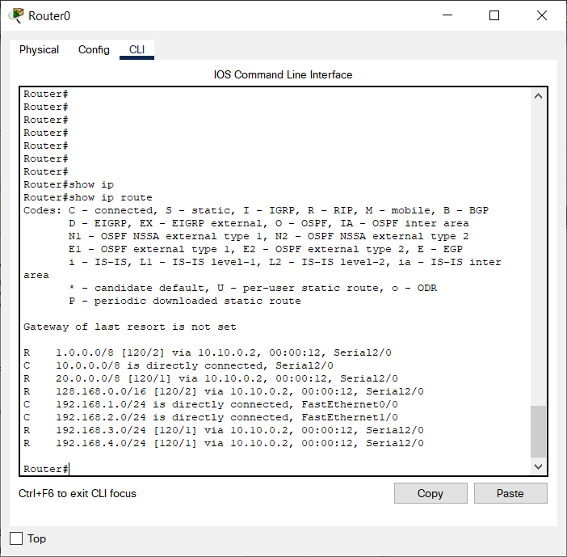
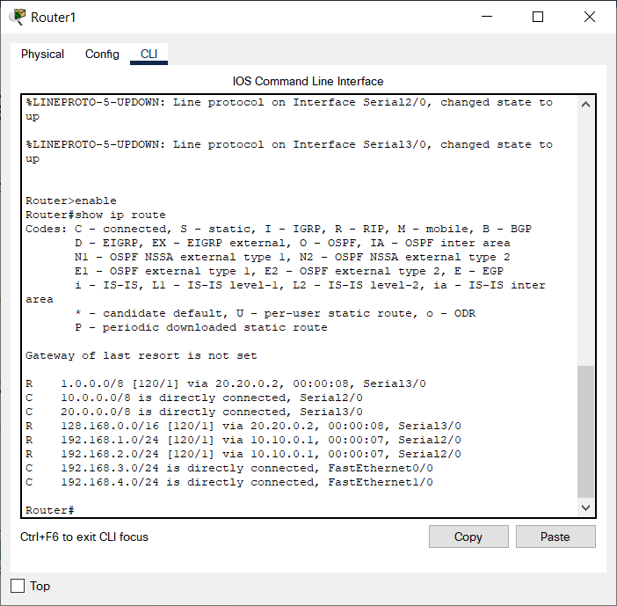
Routing Protocol Plan
Routing Information Protocol (RIP) is a dynamic routing protocol which uses hop count as a routing metric to find the best path between the source and the destination network. It is a distance vector routing protocol which has AD value 120 and works on the application layer of OSI model.

Slide 15
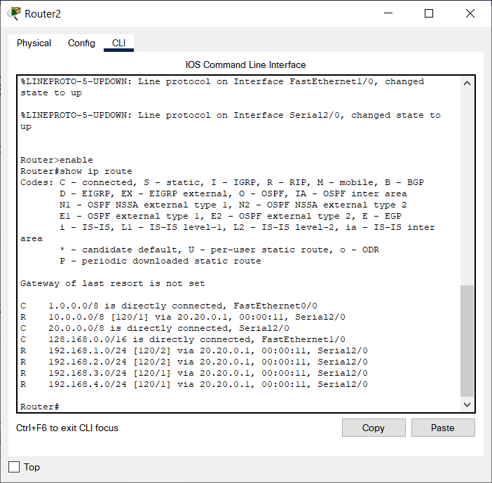
Routing Protocol Plan

Slide 16
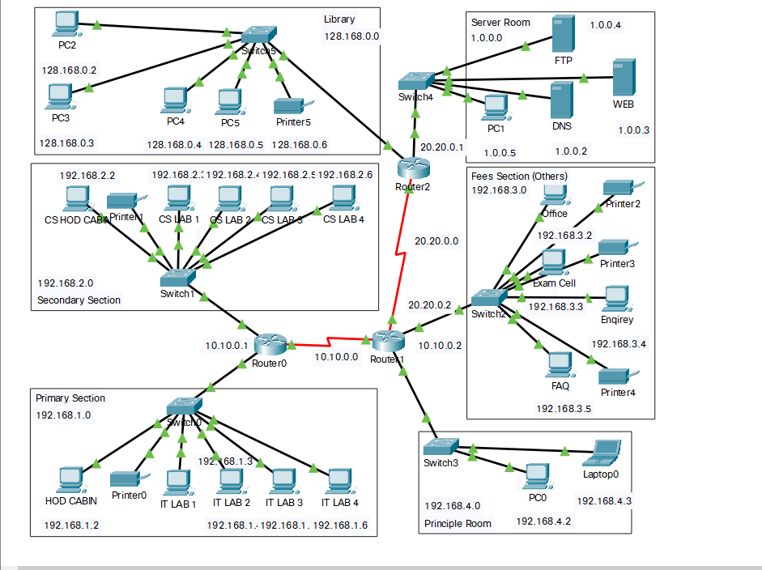
Network Design
The prototype of the proposed network is implemented on cisco packet tracer

Slide 17
Conclusion
The outcome of the proposed system will be a fail-safe backbone network infrastructure which meets the requirements for readily available access to information and security of the private network, and also ensures optimized productivity.
The installed equipment allowed to organize high-speed wired and wireless Internet access throughout the whole complex of school buildings as well as providing transfer of all types of data throughout the single optimized network.

Slide 18
References
1) Sun, L., Wu, J., Zhang, Y., & Yin, H. (2013, April). “Comparison between physical devices and simulator software for Cisco network technology teaching”. In Computer Science &Education (ICCSE), 2013 8th International Conference on (pp. 1357-1360). IEEE
2) Roberto Minerva AbiyBiru, "Towards a Definition of the Internet of Things” IEEE IOT Initiative white paper.
3) “Design and Simulation of Local Area Network Using Cisco Packet Tracer”. The International Journal of Engineering and Science (IJES) || Volume || 6 || Issue || 10 || Pages || PP 63- 77 || 2017 || ISSN (e): 2319 – 1813 ISSN (p): 2319 – 1805.
4) Qin, X. U. E. "Simulation Experimental Teaching of Computer Network Based on Packet Tracer [J]." Research and Exploration in Laboratory 2 (2010): 57-59.
5) Current, John R., Charles S. ReVelle, and Jared L. Cohon. "The hierarchical network design problem." European Journal of Operational Research 27.1 (1986): 57-66.

